Slide 1
Automated Training Data Generation for Geometrical Machine Learning
Team: nullPointer
Team member: Allen Jiang, Bryant Porras, Kuanren Qian, Shu You, Vimalesh Vasu,

Slide 2
What will the program do?
C++ Program that automates simulation softwares to produce training data for machine learning algorithms
Target problem: Vacuum nozzle batch fluid simulations
Issues to tackle:
Parametric user input
Geometry(Mesh) shape, position
Simulation condition
Batch simulations using commercial softwares
Processing large simulation data for analysis
Primary goal: Automates simulation results analysis and visualization based on user input parameters

Slide 3
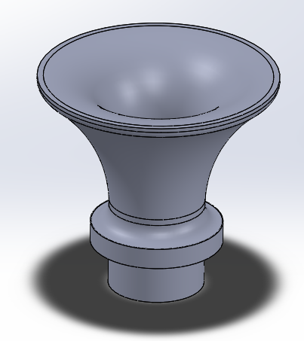
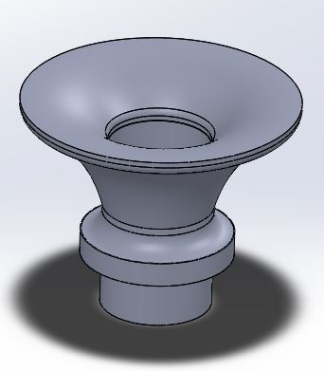
Application Example: Vacuum Nozzle Design Simulations
Vacuum design optimization requires complex fluid simulations to solve
There is a large range of potential geometries that can be made
Iterating through such geometries and running fluid simulations on each can be time consuming, and tedious
A batch simulation would be able to run through a large set of geometries in one program run and output all simulation results for a user to qualitatively judge which geometry is best

Slide 4
Why choose this topic?
The program could:
Inform and assist design choice
Providing optimizations based on qualitative judgements
Display batch results on a gui for quick scanning
Removing unnecessary intermediate steps for visualization using softwares
Significantly reduce repetitive manual labor
Data generation - converting and transferring large quantity of files between softwares

Slide 5
What will the program do?
The program will:
Take user inputs and goal as parameters to calculate necessary geometries
Generate simulation input files (e.g. “.inp”)
Conduct batch simulations using commercially available softwares (Abaqus)
Import and visualize simulation results in GUI

Slide 6
Why Project is of Reasonable Difficulty
Simple:
Small number of steps to automate (running simulations, and outputting onto gui)
Simple gui
Challenges:
Interfacing with CAD software
Ensuring parameters input are robust and simulations don’t crash
Dealing with large computing cost of batch simulating

Slide 7
Questions?

